Slide 1
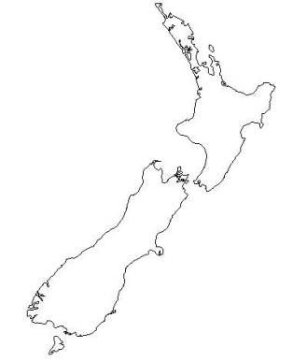
WONCA Asia Pacific Meeting, <location>, <month> <Year>
New Zealand
<Small map of country>
Felicity Goodyear-Smith
Department of General Practice & Primary Health Care
University of Auckland, New Zealand

Slide 2
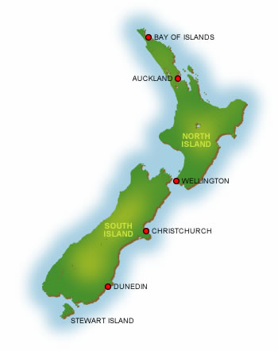
Demographics of New Zealand’s population
Population 4.6 million
Distribution >80% urban
Ethnicity
NZ European 74%
Māori 16%
Asian 12%
Pacific peoples 8%
Unemployment rate 4.9%
Life expectancy ♀ 83.3 years ♂ 79.6 years
Notes:
Basic demographics:
Population
Distribution (eg urban / rural / remote)
Socioeconomic breakdown
Ethnic groups
Other relevant characteristics eg religions

Slide 3
Clinical disciplines working in primary care in the community
GPs, practice & public health nurses, midwives, many allied heath workers
Shortage in many rural areas
Many rural GP positions filled by overseas medical graduates, locums
Aging medical & nursing rural workforce
Notes:
Which disciplines Constitute PHC (family physicians, nurses, midwifes, allied health professionals)
Availability PHC disciplines and distribution in the country

Slide 4
Training & registration
Robust training programmes particularly for GPs, nurse practitioners, midwives
Government regulation eg NZ Medical Council, NZ Nursing Council, Pharmacy council
Maintenance of professional standards & reaccreditation standards eg for GPs through NZ Royal College of General Practitioners, approved by the Medical Council, to retain vocational registration
Notes:
What training programmes are there? Eg family medicine, midwives, nurses, pharmacy etcis it obligatory?
What government regulation is there?
Any reaccreditation / maintenance of professional standards requirements?

Slide 5
PHC as point of access for health care
<Small map of country>
GP /family physician is gatekeeper
Referrals needed to all other medical specialities
Some community pharmacists, nurse practitioners, midwives, physiotherapists may be first contact
Notes:
Is PC the gatekeeper?
Can other specialties work in community with direct /open patient access?

Slide 6
Relation of PC with other community services
<Small map of country>
Almost all GPs work with practice nurse, also receptionist & practice manager
Increasing number custom-built group practices, often with community pharmacist, laboratory & radiology services on site
Trend towards integrated centres with allied health & social services (eg mental health, podiatry, nursing & social worker out-reach)
Notes:
Relation primary health care and other community services
Involvement of PC professionals in intersectorial actions
Is there collaboration of primary health care professionals with other community services (social welfare)?
To what extent is this structured or ad hoc?
Are there contacts with community leaders/patient representatives?
If so, do they have a formal role or is it ad hoc/informal?

Slide 7
Networks of practices (PHOs) hold funds & implement programmes rolled out to all practices Team approach enables systematic approach & high coverage (eg immunisation, cancer & CVD screening, diabetic checks) Well-funded PHOs include social services & community out-reach
How teams support or impede
response to community needs
Notes:
Ways in which community based primary healthcare teams are a support or impediment to respond pro-actively to health needs in communities:
Are PC disciplines employed/paid by same funder/organisation or by different sources?
Are PC disciplines paid in the same way for the care they provide (capitation; item for service)?
Is their care for patients accessible in the same way, or do patients encounter different (financial) barriers?
Do all PC disciplines share the same population/community or do they cover different areas?

Slide 8
How is PHC financed?
<Small map of country>
Blended model:
Capitation to care for enrolled population
Some subsidised or free services
Variable fee-for-service
Paid for performance
ACC – government funding for accidents
Some private insurance
Notes:
Capitation?
Fee for service?
Paid for performance?
Blended?
Insurance?

Slide 9
Strengths of PHC in New Zealand
General practices have enrolled populations & are responsible for health prevention programmes as well as curative care
Universal coverage – everyone enrolled in a practice
All practices belong to Primary Health Organisations with capitated funding & performance payments providing wide range of community services, health promotion & prevention
Collation of data eg prescribing , investigation ordering with feedback to outliers
Team approach enables GPs, nurses to work at top of scope
Devolution of secondary out-patient care into community
PHOs enables
Notes:
What is role and scope of family medicine / GP?
How universal is the coverage and access?
Positive impact on PHC system, enablers of care
Summarise models of success
Is there a relation to PHC development (teaching, education, research)?

Slide 10
What barriers are encountered?
Funding restraints: 32 PHOs that differ in size, governance, policy Different practice ownership models (eg owned by GPs, Trusts, corporates, District Health Boards) Poor hospital referral back to community care Midwives generally prefer to work independently
Notes:
Present barriers that stand in the way of implementing PHC in your country

Slide 11
In general, family & patient-centred comprehensive primary care Continuity of care Both individual & population-based Often poor communication & transfer of care at primary / secondary interface
Lessons for other countries
Notes:
Summary of what works well and does not work well that other countries may learn from

